Slide 1
A Survey of Uncertainty Quantificaiton
师清
2023.9.27

Slide 2

Introduction
确定，是指同一个结果经得起多次反复问询和质疑的
不确定性，度量的是一个随机变量的离散程度
对于DNN中不确定性的度量，我们如何对单一输入，模拟得到多次问询的结果?我们如何计算不确定性？又如何评估方法的有效性？
how to model uncertainty?
how to measure uncertainty?
how to test uncertainty?

Slide 3
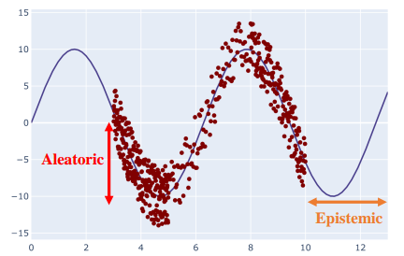


Introduction
不确定性分类
Aleatoric/data uncertainty：uncertainty that directly stems from the data
Epistemic/model uncertainty：uncertainty caused by shortcomings in the model
Distributional uncertainty

Slide 4
Introduction
根据输入数据的domain,预测uncertainty可以分为三类
in-domain:和训练数据分布一致的分布
domain-shift:与训练数据分布有偏移，比如数据增强，攻击
out-of-domain: 来自未知数据子空间的样本，OOD样本

Slide 5
Methods
贝叶斯方法（Bayesian methods）：在BNN网络中，认为每一个权重不再是某个具体的数值，而是一个概率分布
集成方法（Ensemble methods）：推理时结合了几个不同的确定性网络的预测
单一确定性方法（Single deterministic methods）：给出基于确定性网络中单次前向传播的预测。不确定性量化可以通过使用额外的（外部）方法获得，也可以由网络直接预测。
测试增强方法（Test-time augmentation methods）：基于单个确定性网络的预测，但在测试时增强输入数据，以生成几个预测，用于评估预测的确定性。
single or multiple,deterministic and stochastic？

Slide 6
Methods
测试增强方法（Test-time augmentation methods）：基于单个确定性网络的预测，但在测试时增强输入数据，以生成几个预测，用于评估预测的确定性
How to select valid augmentation

Slide 7

Methods
Learning-based method for test time augmentation(TTA)
《When and Why Test-Time Augmentation Works》
Performance of TTA depend on the training set, architecture, and augmentations involved.
We derive a new TTA method that learns to aggregate predictions from different transformations for a given model and dataset.

Slide 8
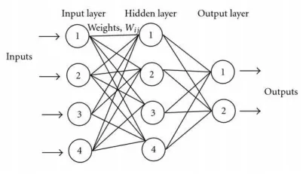
Methods
单一确定性方法（Single deterministic methods）：给出基于确定性网络中单次前向传播的预测。不确定性量化可以通过使用额外的（外部）方法获得，也可以由网络直接预测。
internal UQ approaches
external UQ approaches

Slide 9

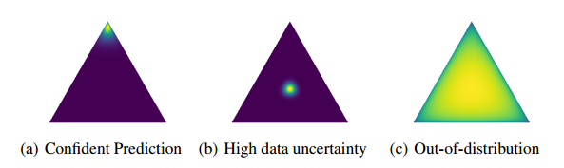



Methods
Dirichlet Prior networks:《Predictive Uncertainty Estimation via Prior Networks》NeurIPS 2018
A Prior Network for classification parametrizes a distribution over a simplex, such as a Dirichlet
precision
concentration
multi-task training

Slide 10


Methods
《Uncertainty Estimation Using a Single Deep Deterministic Neural Network》ICML 2020
Deterministic Uncertainty Quantification(DUQ)
a deep feature extractor without softmax layer(ResNet) + learnable centroids
The class centroids are updated using an exponential moving average of the feature vectors of data points belonging to that class
two-sided gradient penalty: encourage sensitivity, avoid feature collapse, enforce smoothness
DUQ do not have a formal way to distinguish between these two kinds of uncertainty in DUQ

Slide 11

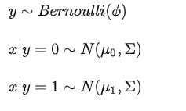
Methods
《Deep Deterministic Uncertainty: A New Simple Baseline》 CVPR2023
To quantify epistemic uncertainty, we fit a feature-space density estimator after training. We use Gaussian Discriminant Analysis(GDA) with a single Gaussian component per class.
To quantify aleatoric uncertainty , we use the entropy of the softmax distribution
regularized feature-space, achieved vis residual connections and spectral normalization to encourage Smoothness & Sensitivity
GDA
epistemic uncertainty
aleatoric uncertainty
entropy of the softmax distribution

Slide 12
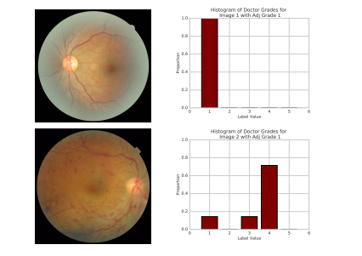
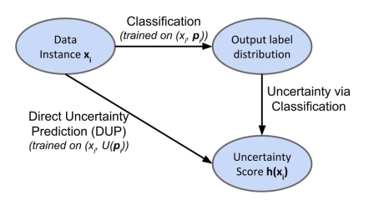
Methods
《Direct Uncertainty Prediction for Medical Second Opinions》
Direct Uncertainty Prediction (DUP), training a model to predict an uncertainty score directly from the raw patient features
Uncertainty vis Classification(UVC) vs Direct Uncertainty Prediction(DUP)
DUP gives an unbiased estimate of the true uncertainty scores U(xi), while Uncertainty via Classification has a bias term
糖尿病性视网膜病变(DR)

Slide 13
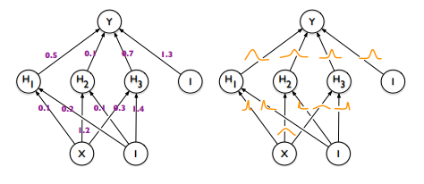
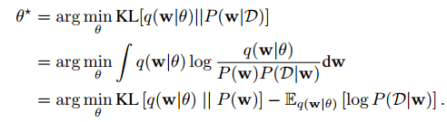
Methods
Bayesian methods
Variational inference
Sampling approaches
Laplace approximation
变分分布q(w)
BNN

Slide 14
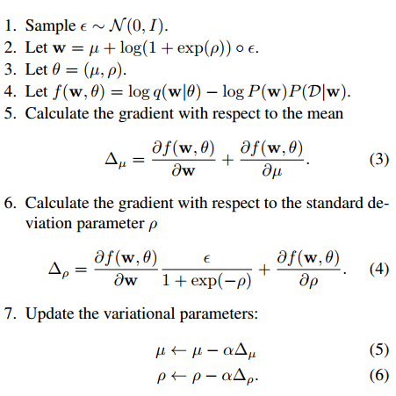
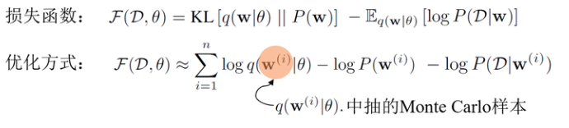

Methods
Variational Inference
Bayes by Backprop: 《Weight Uncertainty in Neural Networks》 ICML 2015
Stochastic Gradient Variational Inference (SGVI) + Reparameterization Trick
Scale Mixture Prior
SGVI
Prior

Slide 15
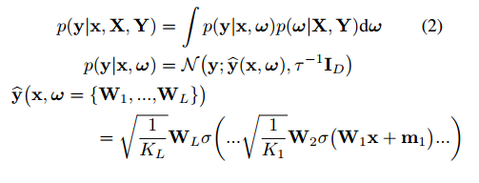


Methods
Variational Inference
《Dropout as a Bayesian Approximation:Representing Model Uncertainty in Deep Learning》
ICML 2016
MC Dropout: active dropout not only during training, but also at test time
variational distribution q(z)
prediction

Slide 16



Methods
Laplace approximation
Kronecker Factor Approx:《A Scalable Laplace Approximation For Neural Networks》
ICLR2018，University College London Alan Turing Institute
Diagonal Laplace Approximation
Kronecker Factored Laplace Approximation
Without having to retrain them.
Laplace Approximation

Slide 17

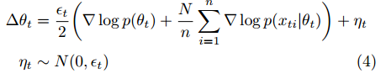
Methods
Sampling approaches
SG-MCMC:《Bayesian Learning via Stochastic Gradient Langevin Dynamics》
ICML, 2011
combine Robbins-Monro type algorithms which stochastically optimize a likelihood, with Langevin dynamics which
injects noise into the parameter updates
stochastic optimization
inject Gaussian noise
1. In the initial phase the stochastic gradient will dominate and the algorithm will imitate stochastic gradient ascent algorithm.
2. In the later phase the injected noise will dominate, so the algorithm will imitate a Langevin dynamics MH algorithm,
3. We should only start collecting samples after it has entered its posterior sampling phase

Slide 18
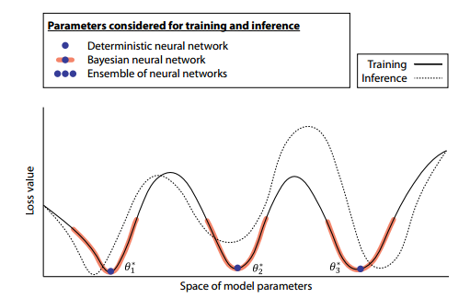
Methods
Ensemble methods
Single-Mode and Multi-Mode Evaluation
Bringing Variety into Ensembles
Random Initialization and Data Shuffle
Bagging and Boosting
Data Augmentation
Ensemble of different Network Architecture

Slide 19
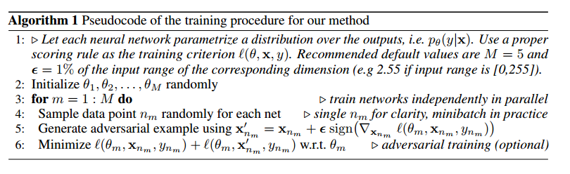
Methods
deep Ensemble:《Simple and Scalable Predictive Uncertainty Estimation using Deep Ensembles》
google, NIPS2017
use proper scoring rule as training criterion:likelihood/Brier score/mean+variance
Adversarial training
Ensembles: randomization-based and boosting-based approaches

Slide 20
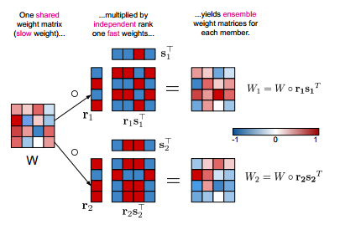
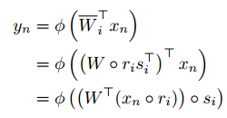
Methods
Making Ensemble Methods more Efficient 《BatchEnsemble: An Alternative Approach To Efficient Ensemble And Lifelong Learning》
Google, ICLR2020
Adress computational and memory bottleneck
Defining each weight matrix to be the Hadamard product of a shared weight among all ensemble members and a rank-one matrix per member

Slide 21
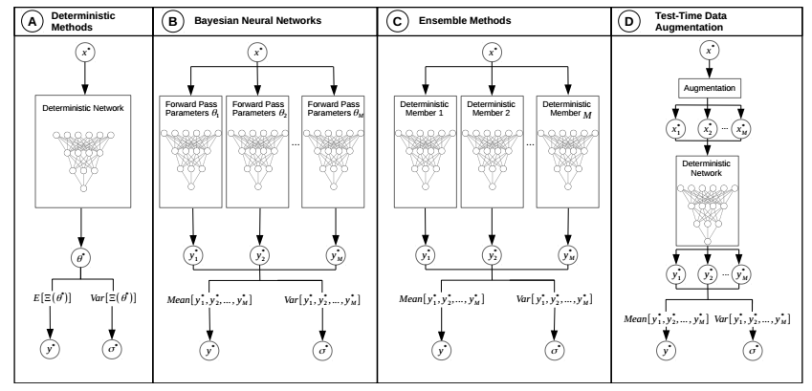
Methods

Slide 22
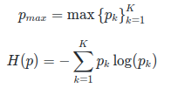
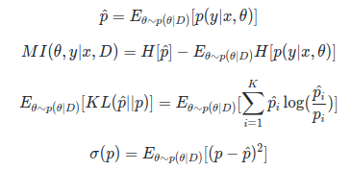
Uncertainty measure
Evaluating Uncertainty in classification tasks
measure data uncertainty
measure model uncertainty
performance measure on complete dataset:AUROC/AUPR

Slide 23
Uncertainty measure
Evaluating Uncertainty in Regression Tasks
measure data uncertainty: STD/prediction interval
measure model uncertainty: approximating an average prediction and measuring the
divergence among the single predictions

Slide 24
Tasks,Datasets,Baselines
tasks
regression
classification
ood detection
robustness against adversarial attack
active learning
reinforce learning
datasets
toy dataset,MNIST,FashionMNIST,CIFAR10,CIFAR100,SVHN,ImageNet
baselines
MC dropout,deep Ensembles,softmax output

Slide 25
Applications
Active Learning,Continual Learning,Reinforcement Learning
Image Processing and Computer Vision:depth estimation,object detection,semantic segmentation....
Medical analysis
Autonomous driving
nlp tasks

Slide 26

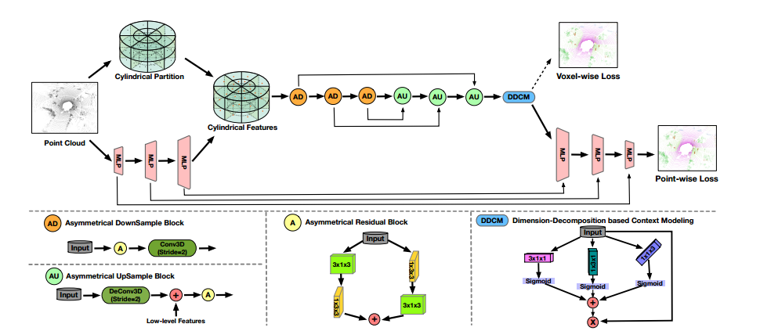
Applications
《Cylindrical and Asymmetrical 3D Convolution Networks for LiDAR Segmentation》
CVPR2021

Slide 27
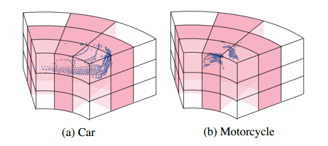
Applications
LiDAR point clouds: sparsity and varying density
Cylindrical Partition：CxHxWxL, where C denotes the feature dimension and H, W, L mean the radius,azimuth and height
Asymmetrical 3D Convolution: Asymmetrical Residual Block,Dimension-Decomposition based Context Modeling🤔
Point-wise Refinement Module：the lossy cell-label encoding, voxel-wise loss+point-wise loss🤔

Slide 28
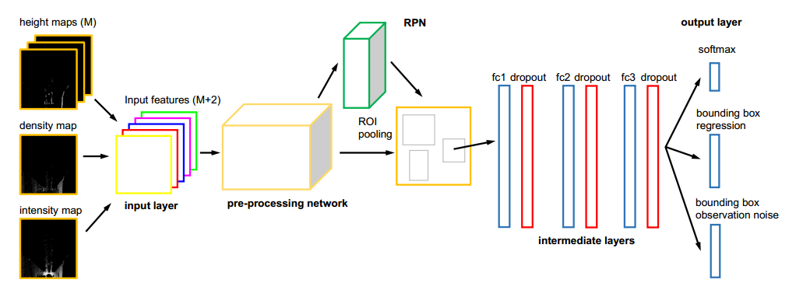
Applications
《Towards Safe Autonomous Driving: Capture Uncertainty in the Deep Neural Network For Lidar 3D Vehicle Detection》
ITSC 2018
3D point clouds

Slide 29
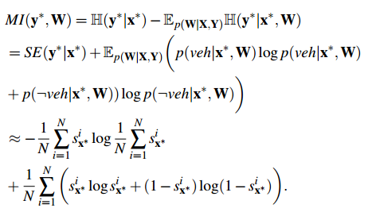

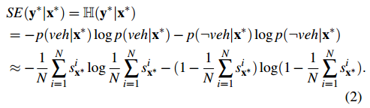
Applications
Capturing Epistemic Uncertainty
3D point clouds
For classification

Slide 30

Applications
Capturing Epistemic Uncertainty
3D point clouds
For regression

Slide 31

Applications
Capturing Aleatoric Uncertainty
3D point clouds
For classification
For regresssion

Slide 32
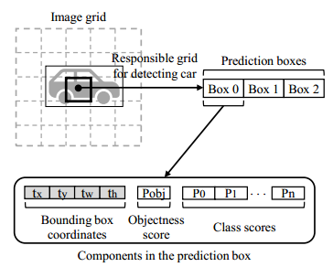
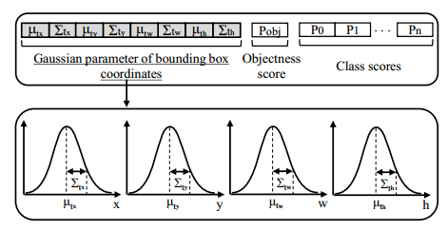
Applications
《Gaussian YOLOv3: An Accurate and Fast Object Detector Using Localization Uncertainty for Autonomous Driving》
ICCV 2019

Slide 33
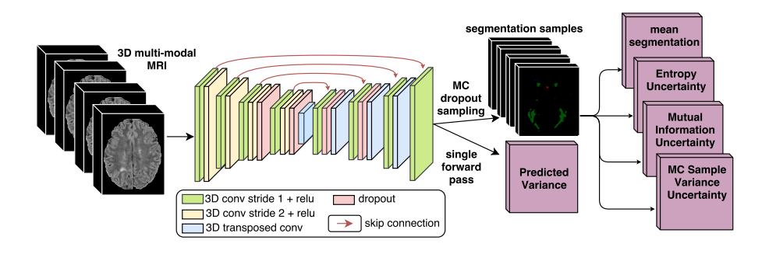

Applications
《Exploring Uncertainty Measures in Deep Networks for Multiple Sclerosis Lesion Detection and Segmentation》
MICCAI 2018
Network architecture: 3D FCN, four uncertainty measures
Fw
Vw

Slide 34

Applications
Exploring Uncertainty Measures in Deep Networks for Multiple Sclerosis Lesion Detection and Segmentation》
Voxel level, Lesion level
Our results indicate that filtering based on uncertainty improves lesion detection accuracy
Fw
Vw

Slide 35


Calibration
什么是calibrated network
for classification:
for regression:

Slide 36

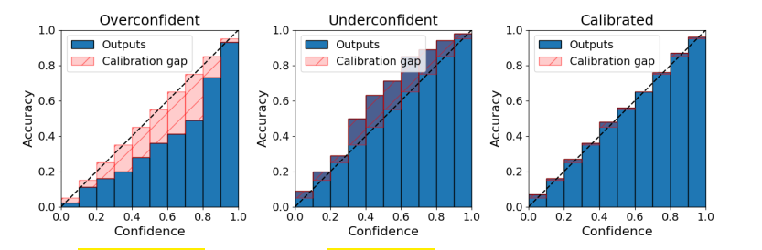
Calibration
什么是calibrated network
reliability diagram: accuracy versus confidence
Evaluating Calibration Quality

Slide 37
Conclusions
Missing Validation of Existing Methods over Real World Problems
Lack of Standardized Evaluation Protocol
Inability to Evaluate Uncertainty Associated to a Single Decision, Lack of Ground Truth Uncertainties
Generic Evaluation Framework
Lack of Explainability

Slide 38


